Slide 1
Progress Report
October 23, 2023

Slide 2
Project Management

Slide 3
Lillian Greenberg
Frequent Communications with Customer
Emailed back and forth weekly as the project moves forward with questions and updates
Scheduling and Attending Meetings
Sept 18 & 27, October 16, took notes and facilitated discussions
Creation of Presentations
Developed the Slides documents and polished them up
Consolidation of bi-weekly reports
Collected all reports from team leaders and created a condensed version

Slide 4
R&D + SysOps

Slide 5
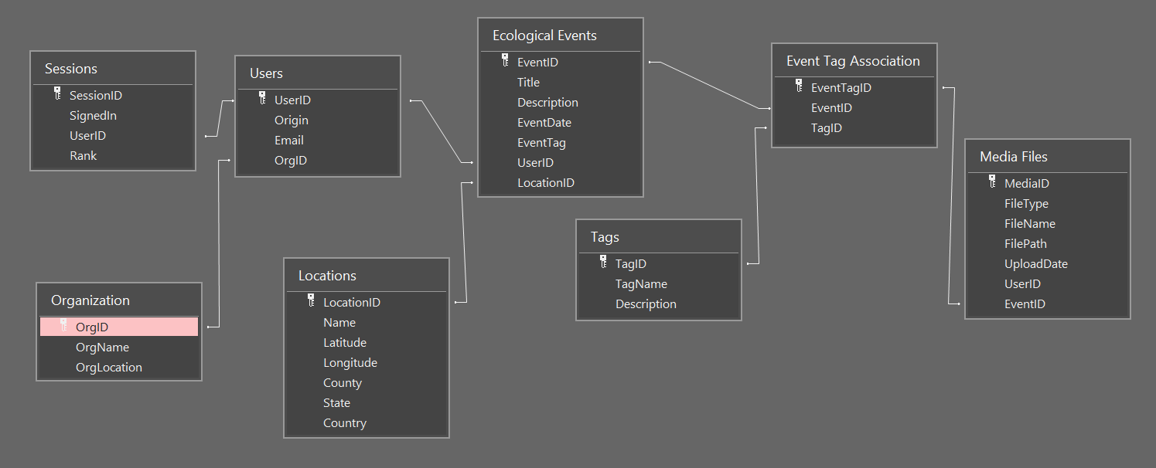
Shameer Rao
Database Schema
Designed the database outline
MongoDB API test implementation
Created Mock Database MS Access
Audio/Visual Upload
Google Map API
Built-In Marker Upload
Google.Maps.InfoWindow
Azure
Worked with SysOps to get Azure Instance running
Secured Free $200/month educational credit

Slide 6
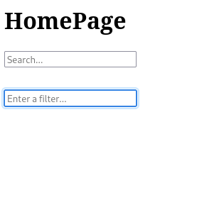

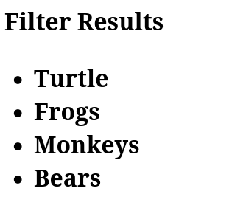
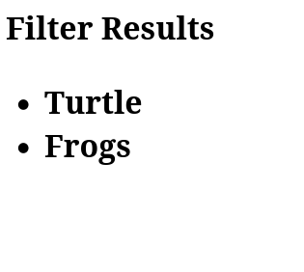
Jordan Golden
Search by text
Text search of database
Placeholder for testing
Search by filter
Input a filter
Display entry names by filter

Slide 7
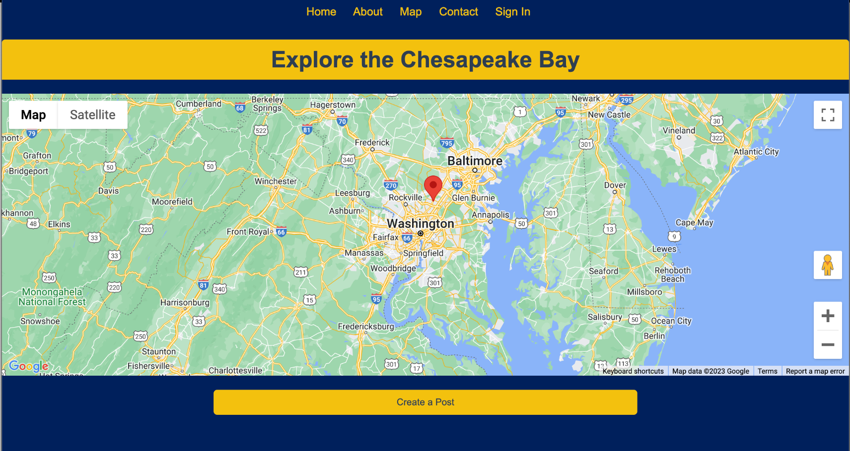
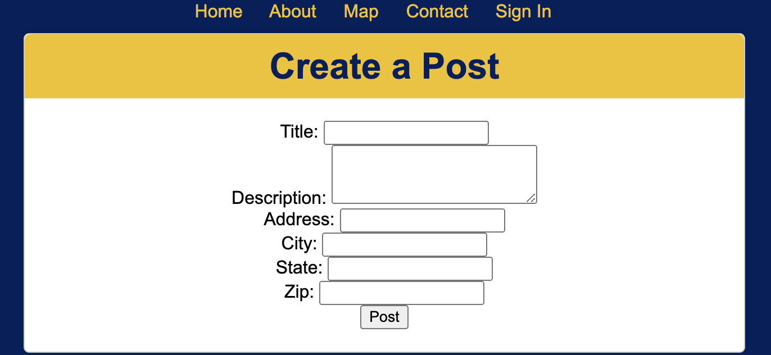

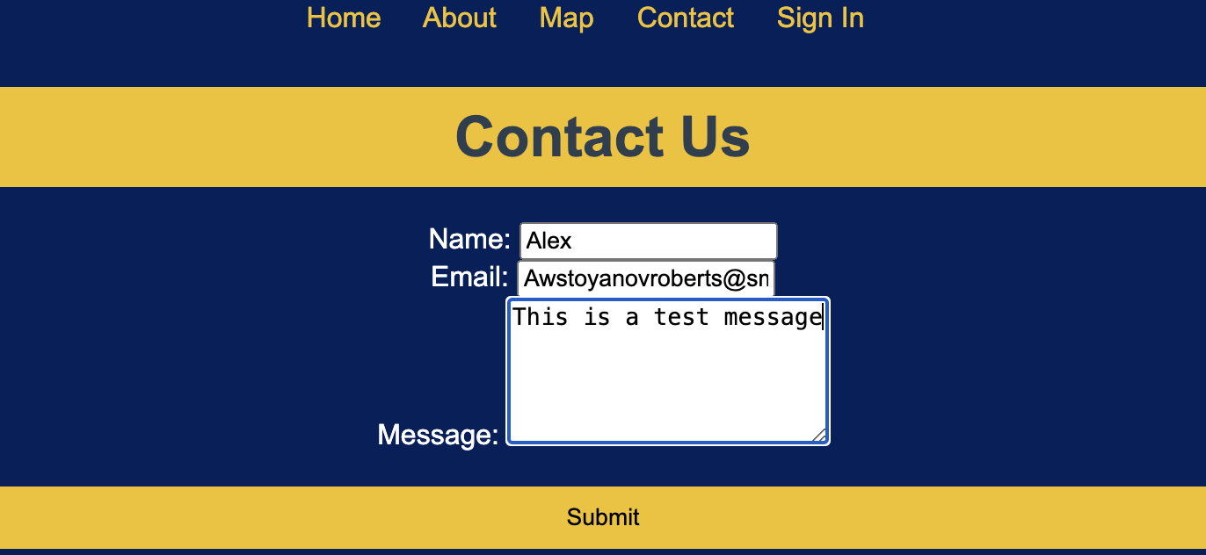
Alexander Stoyanov-Roberts
Created a mock up of the website:
Made a localhost HTML/JS/CSS site with tab
Integration and SMCM branding.
Integrated an interactive map and widget system:
Allows the user to create a widget by filling out a
form with the address and identifiers and a widget appears
Integrated google one tap API:
Got the google onetap API button displaying on the page
sign in still not possible on site as it is a localhost site.
Began work on framework for a contact us page:
Form would be submitted on the website and available to
read with correct permissions.

Slide 8
Matthew Grimelli
Local Working Map
Created a basic Google Maps widget to build the site on
Azure Setup
Set up an Azure Account and researched how to use it
Implemented Local Site into Azure
Began process of making the local site public using Azure

Slide 9
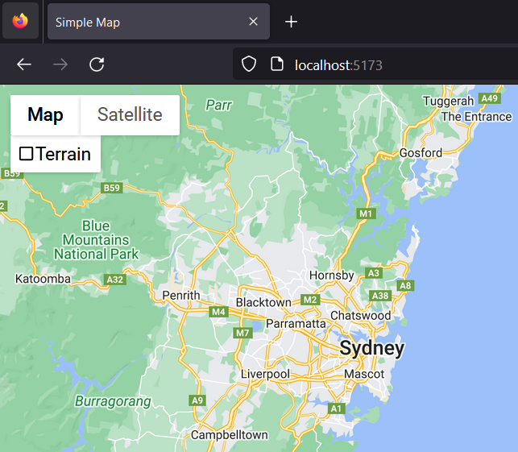
Samuel Albanese
Local Map Template
Implemented a local environment to play with and tweak the Google Maps API.
Google Maps API Research
Researched using the Google Maps API documentation for ways to make custom map markers and implement those into our future website.

Slide 10
Marjon Ward
Started on the website’s visuals
Included requested pages/links
On-brand colors, font, and theming
Easy navigational design with QA’s help
Map Pins and Icons
Beginning on creating icons and categories

Slide 11
Ariat Ojulu
Progress
Working on the visual side of the homepage
Implementing a simple and positive color scheme.
Looking for more softer, and complementary colors on the site to create a compatible visual atmosphere.
We opted for a clean and easy to read font to enhance text readability.
Next step
We are planning further enhancements to create more engaging user experience with the help of QA.

Slide 12
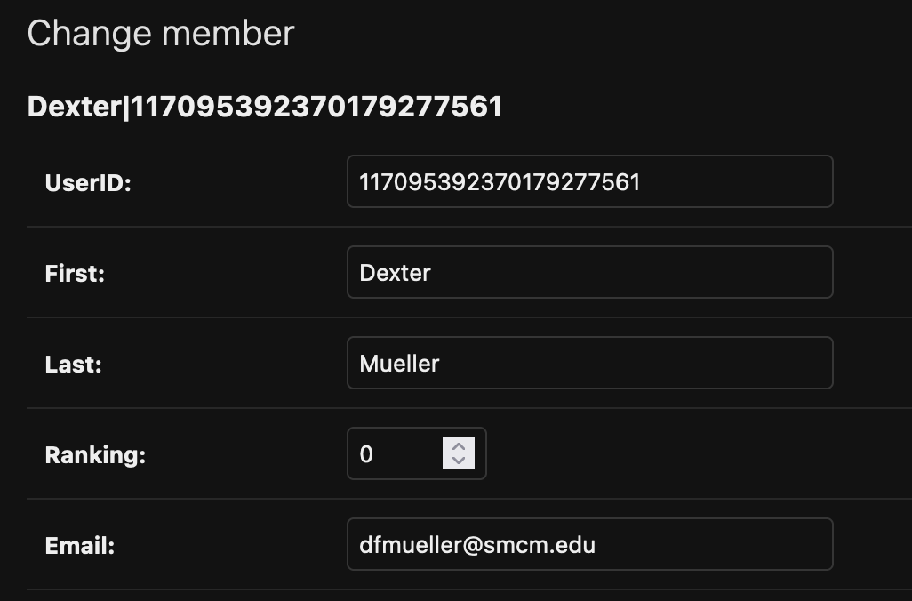
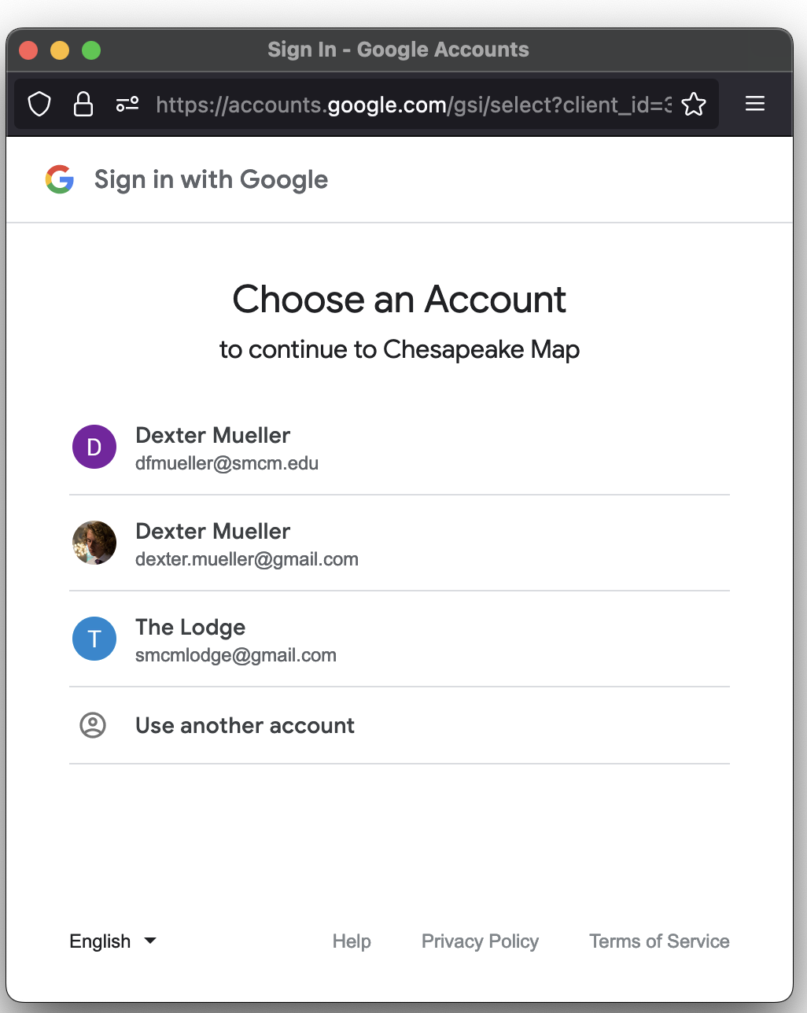
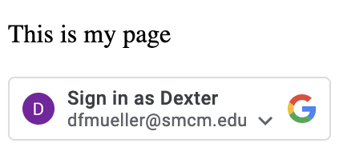
Dexter Mueller
Local Sign Up/Sign In via Google
Created a Django proof of concept of Google's One Touch Sign-in that allows user to sign in with their Google Account and captures their account information into a member model
Rudimentary Local Session Management
Have completed modeling and started prototyping how to keep track of user sessions using cookies, which is the authorization half of the Google One Touch authentication

Slide 13
Garrett Bridgwater
Server Development
Server free for students
No required credit card information
Microsoft Azure
Best fit for the team
Features

Slide 14
Quality Assurance

Slide 15
Kylie Hall
SDP (Software Development Plan)
Project schedule, System Overview (Purpose statement), Requirement Collecting, Final edits
SRS (Software Requirement Specification)
Big questions (meetings to question requirements that affect the whole project), new big ideas (map layout (Yaro & Brittany), Contributor page, …), communication with R&D, Final edits
SDD (Software Design Description)
Giving guidance to complete (John and Isabella <3)
STP (Software Test Plan)
Easier ways to test

Slide 16
Naheed John
2.2.5.2 User Accessibility and 2.2.5.3 User Submissions
I described how users will be able to access the platform through QR codes, this allows for creatives ways to bring users to the website. For website submissions, I explained how the users would submit resources, links and written words detailing the message they want to get share.
2.2.4.1 Admin Approval Process
I explained how the content that will be submitted to the website will need to be approved by the admin. This is to ensure that the information the user wants to post is appropriate for the website. A safe online community is extremely important.
6.1 Website Delivery
I explained how the Chesapeake Community Website will be delivered by the accessibility of Google Chrome. No other website will be available for use to access this website.

Slide 17
Malik Hill
Contributed to section 2.1 on the SRS document
Added and organized the shall statements from sub-sections 2.1.1.1.3 to 2.1.1.1.5 which mostly covers the homepage and map display
Completed section 5 on the SRS document
Completed the shall statements subsections 5.1 to 5.4 which addresses the performance of the website
Completed section 7 on the SRS document
Added the updated schedule spreadsheet in section 7

Slide 18
John Heinig
Worked on the SDP section 4
Specifically subsections 4.1 (project estimates), 4.2(project plan).,4.3.2(quality control)
Helped write the SRS
Along with Naheed worked to create the body subsections of Website functionalities (2.2)
SDD
Created the Data Flow diagram as well as subsection 4.3 submission interface design along with section 2.1 showcasing the plugins to be used along with other internal data structures

Slide 19
Isabella Stephens
Document Additions:
Organizational Structure (3.1), Roles and Responsibilities (3.3) sections [SDP]
UI requirements (uncategorized) [SRS]
Purpose (1.1), Program Structure (3.1) [SDD]
Initial Homepage Design:
With cooperation from both R&D and QA team members
Document Edits/Suggestions:
SRS/SDD formatting
Miscellaneous elaboration and rewording in SRS document

Slide 20
Brittany Brenneman
Document Additions:
Software Development Plan
Section 2.2 Assumptions and Constraints
Section 4.2.2 Iteration Objectives
Software Requirements Specifications
Section 1 Introduction
Section 3 System Requirements
Document Edits:
Software Requirements Specifications
Section 2 Functional Description
Organized requirements into categories
Uniformed format
Font, paragraph spacing, and headings for table of contents

Slide 21
Yaro Kulchyckyj
Overall
Worked with Kylie and Brittany to figure out a stronger direction to take the ENST project (away from a more comments based focus and to a more database focus)
SDP (Software Development Plan)
4.2.4 Project Schedule Gantt Chart
2.1 Project Purpose, Scope, and Objectives
3.2 External Interfaces
4.3.4 Risk Management
SRS (Software Requirement Specification)
Assisted in organizing the Requirement Sections breakdown
Developing the Necessary Requirements
SDD (Software Design Description)
Assisted in organizing the website structure
Created sketches for how the interface design might look
Working on the Flowchart Reference Key for Procedural Design

